Slide 1
Omni-Channel Marketing
Presented by Sonja Ceri

Slide 2
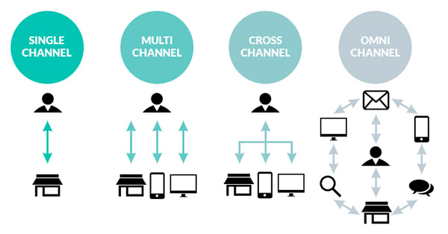
What is omnichannel? And how is it different to multi channel marketing?
Multi-channel marketing refers primarily to reaching the right customers using a number of marketing channels.
Omnichannel marketing focuses on the customer experience to ensure that it is consistent across all touchpoints of the journey.
Notes:
Before we go down the omnichannel marketing rabbit hole with all of its precarious twists and turns, let’s pause and recap on the omni channel definition.
Or is it all just semantics?
The focus of multi-channel marketing is on executing across specific channels whereas omnichannel marketing is channel-agnostic and centers on nurturing a prospect through the entire buyer journey.

Slide 3
Notes:
Hearing all of this might make you say to yourself proudly: “hold on, but most of my marketing is already omnichannel!”
But is it really?
The reality is that you may be ‘multi-channel’ – as defined above – but ‘tis a long hard road to true omnichannel perfection.
It is a highway paved with
siloed technology that doesn’t talk to each other,
channel attribution confusion
and customer backlash as a result of
the irrelevant marketing they have to endure along the way.
Here are some typical roadblocks to implementing a single customer view within an organization:

Slide 4
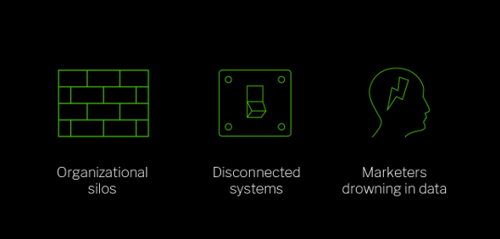
Notes:
So how do you achieve true omnipresence with your marketing so that it supports each stage of the path-to-purchase?
The Evolution From Channel to Mindset Planning

Slide 5
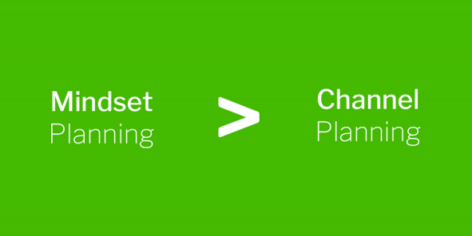
Notes:
While a large part of the ‘quest for the holy omnichannel grail’ is based around aligning stakeholders and integrating systems, there’s a bigger change that needs to happen within your marketing team and the wider business.
This is a change in the way that you approach marketing in general and planning in particular. We marketers refer to this as ‘mindset planning’:

Slide 6
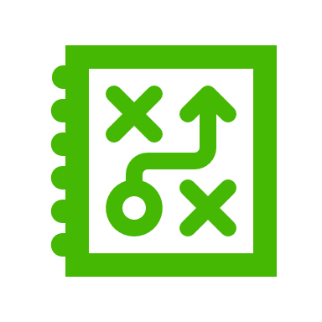
Mindset planning lasers in on the high-level objectives that marketers help the business to achieve and the specific channels themselves become a secondary consideration.
Notes:
It is a considerable shift from how marketing strategy is currently set and evaluated based on KPIs, which includes your usual assortment of CPAs, CPLs, views, impressions, etc.
This way of measuring marketing often has vanity metrics attached to various channels that don’t actually support the intended business outcomes.
To illustrate this point, here’s what the old way of marketing planning looks like:

Slide 7
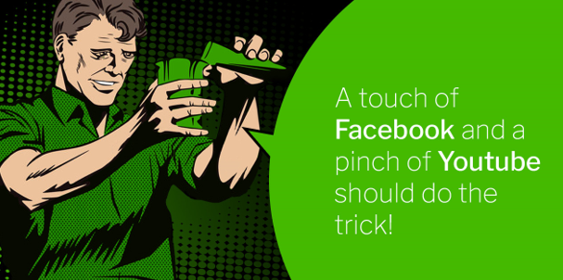
Notes:
Mindset planning flips the traditional planning notion on its head by first zeroing in on the high level business objectives and then using the a framework to break this down to individual goals at each stage of the funnel.

Slide 8
Notes:
Then using an agile approach, messages and other key variables receive ongoing optimisation at each layer of the funnel based on the desired business goals.
This iterative process uses the buyer journey stages as goals and channels become nothing more than experiments that can be validated or not based on performance.
Here’s a summary of the differences between the two approaches:

Slide 9
Tactics & Experimentation
The foundation of mindset planning is a focus on the entire buyer journey and how each funnel stage leads to the next.
While there will be certain channels that are more suitable to each stage, this is not the primary consideration as they are just that – tactics.
These tactics may include direct mail, digital advertising, events or any combination of marketing activities.
The point is to ensure that the right mix of tactics aligns with the end goal of generating a sale or conversion. This can only be through experimentation.

Slide 10
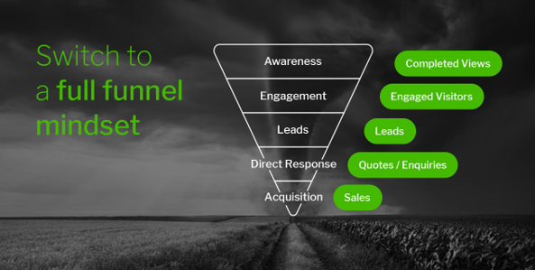

Slide 11
Getting Omnichannel Customer Experience Right By Unifying the Tech
Notes:
While it may sound strange to talk about technology as being the cornerstone of a successful customer experience program, the reality is that, well, it is.
Executing well across multiple marketing channels and then tracking the entire prospect journey from ‘A to B’ as a single customer view is a complex undertaking.

Slide 12
Integration all of the systems in your business – from your CRM and marketing automation system, to your advertising data management platform, call centre software and billing – to make them work in concert.

